Slide 1
Image processing in computer vision
Dr. Sagarika B

Slide 2
Agenda : Session 4
Image representations

Slide 3
What is an image ?
Pixel grid
How they are stored in memory?
The typical format for storing pixels is by byte or eight bits. 8 bits can store 2⁸ amount of information. Grayscale images have 1 channel that goes from a scale from 0 to 255 where 0 is black and 255 is white. Colored images typically have 3 channels and stored as 3 bytes: red, green, blue (RGB) values each ranging from 0 to 255 depending on intensity.

Slide 4
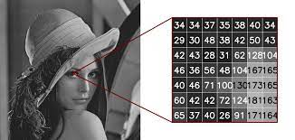
Image representations
Grayscale representation: Images are represented using a single channel where each pixel contains a grayscale value ranging from 0 (black) to 255 (white). This representation is commonly used for tasks that do not require color information.

Slide 5
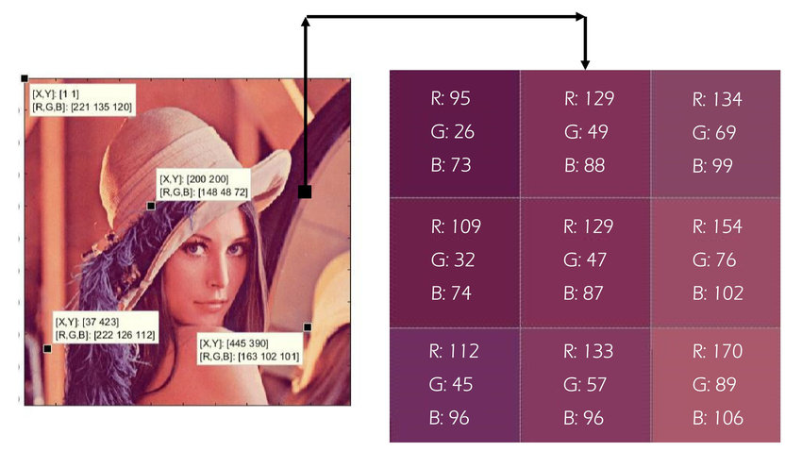
Color representation:
RGB color Space : For color images, the most common representation is the RGB (Red, Green, Blue) format. Each pixel is represented by three color channels (R, G, and B), with each channel containing an intensity value ranging from 0 to 255.

Slide 6
Other color spaces and their usage :
Monitors: RGB
Printers: CMY
Human perception: HSI [hue (the “inherent/pure” color – red, orange, purple, etc.), saturation (the amount of white mixed in the color, i.e. pink versus magenta), intensity (the amount of black mixed in the color, i.e. dark red versus bright red).]
Efficient compression and transmission: YCbCr.
The YCbCr color space is a similarly decorrelated color space with Y being the luminance channel similar to the V in HSV.The luminance channel (Y) carries most information from the point of view of human perception, and the human eye is less sensitive to changes in chrominance.

Slide 7
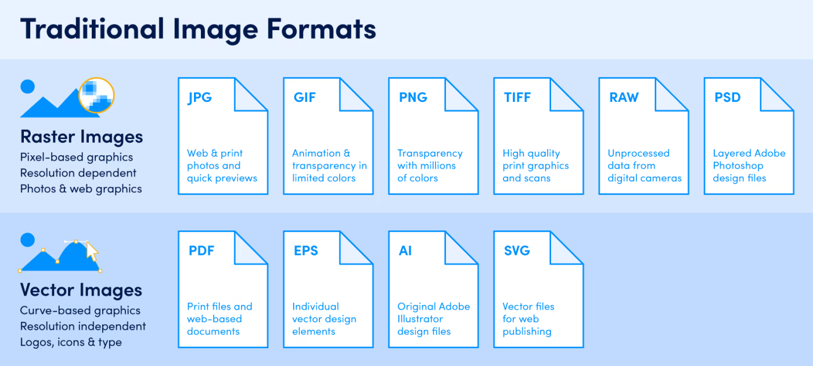
Image formats

Slide 8
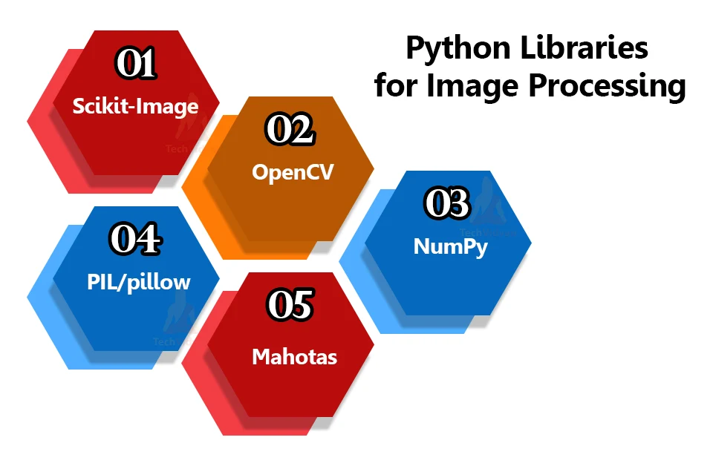
Popular image processing libraries

Slide 9
How to Organize images for computer vision problems?
Main folder
Train dataset
Test dataset
Class 1 images
Class 2 images
…..
Class n images
Class 1 images
Class 2 images
…..
Class n images

Slide 10
Main folder
Class 1 images
Class 2 images
Class 3 images
Class 4 images
Class 5 images
…..
Class n images
Image info can be stored in CSV file and read through it.

Slide 11
Real time image data challenges !!
Very large sized image with lot of details
Images of different size
Image , label mapping might be wrong (Domain expertise might be needed to verify)
Too many images to process

Slide 12
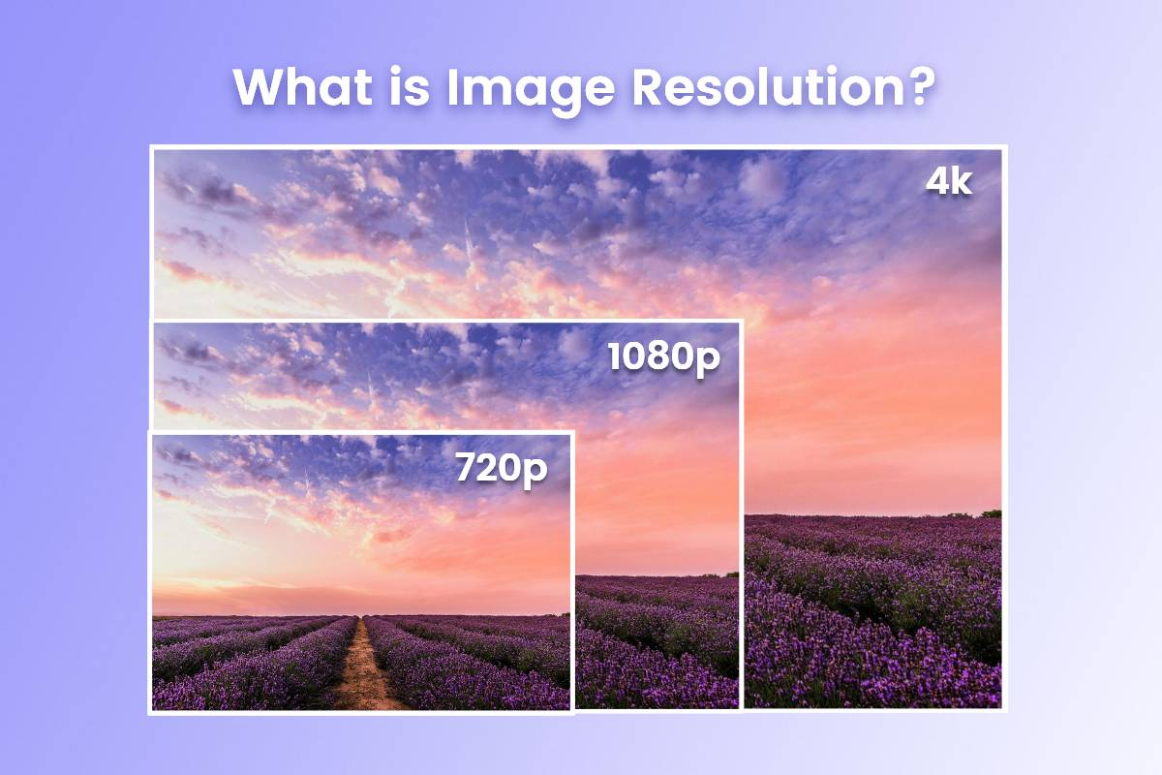

Slide 13
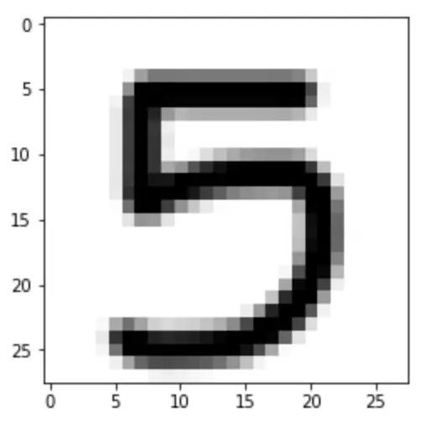
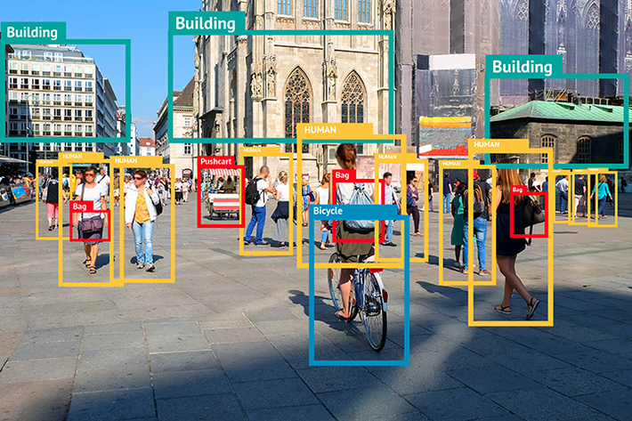
vs

Slide 14
What is Image filtering
Most common filters are linear filters and the process of applying a linear filter is called convolution
Why filter –
Enhance images : Denoise, resize, increase contrast, etc. –
Extract information from images •
Texture, edges, distinctive points, etc.

Slide 15
Linear filters
General process:
–Linear filtering is the filtering method where the value of output pixel is linear combinations of the neighboring input pixels. It can be done with convolution operation. For example, mean/average filters or Gaussian filter.
• Properties
– Output is a linear function of the input
– Output is a shift-invariant function of the input (i.e. shift the input image two pixels to the left, the output is shifted two pixels to the left

Slide 16
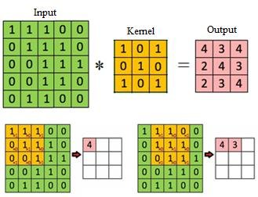
Convolution
In image convolution, involves a kernel, or matrix that is applied over the input image’s pixels to generate an output image. The kernel size and values determine the effect the kernel has on the image. The dimensions of the kernel should be smaller or equal to that of the input image’s.

Slide 17
Edge detection
Edges are sudden discontinuities in an image, which can arise from surface normal, surface color, depth, illumination, or other discontinuities.
Edges are important for two main reasons.
1) Most semantic and shape information can be deduced from them, so we can perform object recognition and analyze perspectives and geometry of an image.
2) They are a more compact representation than pixels.

Slide 18
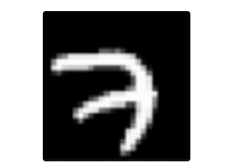
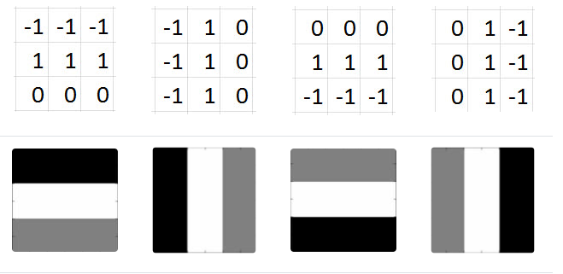
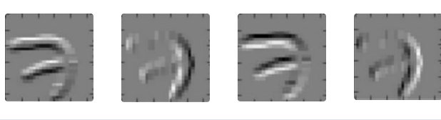

Slide 19
Image features
Think about how much may be going on in any single image. Multiple edges, shapes, textures, objects, etc. These are what we mean by patterns.
edges
shapes
textures
curves
objects
colors

Slide 20
Aside from edges, some filters may detect corners. Some may detect circles. Others, squares. Now these simple, and kind of geometric, filters are what we'd see at the start of a convolutional neural network.
The deeper the network goes, the more sophisticated the filters become. In later layers, rather than edges and simple shapes, our filters may be able to detect specific objects like eyes, ears, hair or fur, feathers, scales, and beaks.
In even deeper layers, the filters are able to detect even more sophisticated objects like full dogs, cats, lizards, and birds.

Slide 21
Good materials
https://ai.stanford.edu/~syyeung/cvweb/tutorial1.html#:~:text=Image%20filtering%20changes%20the%20range,points%20without%20changing%20the%20colors.

